Slide 1
Year 12 Information Evening
September 2021
Welcome!

Slide 2
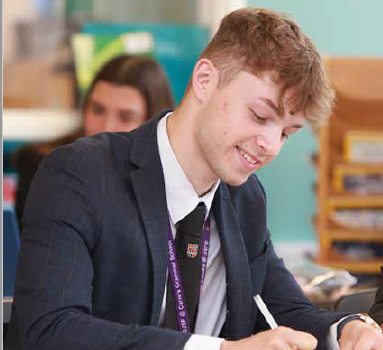
Our Aim
To help each student to achieve their full potential:
Qualifications which open doors
A place at their preferred post-
18 institution or employer
Skills for life

Slide 3
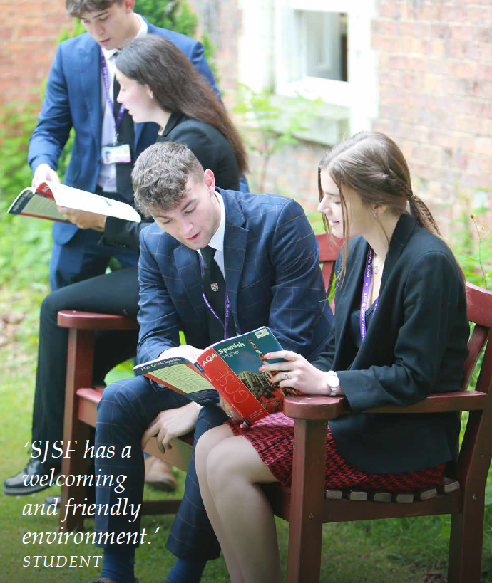
We will…
Track your son/daughter’s academic progress
Discuss causes for concern from subject teachers and praise successes
Discuss strategies for support, if required
Monitor attendance at all lessons and tutorials
Provide pastoral support and care, when needed
Communicate with you about your daughter/son’s progress and if there are any problems
Provide guidance about post-18 options
Provide opportunities for extra-curricular activities

Slide 4
We expect our students to…
Work hard – to the best of their ability
Have good attendance and punctuality
Follow the Sleaford Joint Sixth Form Code of Conduct
Not to undertake more than 8 hours a week of paid employment
Talk to us – Tutors, Sixth Form Team, Subject Teachers
Participate in enrichment activities and the wider life of the school

Slide 5
We would like you to…
Encourage your daughter/son to achieve their best
Attend parents’ evenings
Communicate with us – Tutors, Sixth Form Team, Subject Teachers
Let us know about absences in advance or on the day (letter, phone or e-mail)
Let us know any issues at home/out of school that may affect your daughter/son in school
Let us know about any concerns you have about their progress earlier rather than later

Slide 6
The Sixth Form Team
Miss Sarah Chant Head of Sixth Form
Mrs Pauline Hunter Sixth Form Administrator/Careers Leader
Mrs Amy Ellison Sixth Form Tutor 12A
Mrs Bronwyn Fleming Sixth Form Tutor 12F
Mrs Kylie Cowell Sixth Form Tutor 12L
Mrs Linda Harbin Attendance Officer Reception
Mrs Sarah Ross Examinations Officer School Office
Mr Jem Green RCT Director of Finance Finance Office KSHS
Bursary Advisor
Mrs Deborah Collett Designated Safeguarding Lead Assistant Head Office
SENCo
Mrs Michelle Watts SEND Manager/Student Support House/Key Stage Office
Mr Brendan Rooney Enrichment Lead PE Office – Carre’s

Slide 7
Sixth Form Attendance
Morning registration with tutors starts at 8.45am for all students
95% attendance is a government expectation
Below 90% parents/carers will be informed by letter and we may want to discuss this with you.
Attendance is expected at:
  Tutor time
  All lessons
  Official timetabled supervised study sessions
  Core/assembly
  Extended Project Qualification lessons (if selected)
  Wednesday afternoon Enrichment sessions

Slide 8
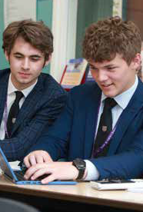
Planned Absences
If a student takes time out of school for a medical/dental appointment, university open day, interview, work experience or sport activity which has not been arranged through the school, the student must inform Mrs Harbin on Reception and collect, complete and return an ‘Application for Time Out of School’ form.
Requirement for students to get a signature from their teachers (for missing lessons) and a parent/carer.

Slide 9
Unexpected Absences Procedure
If there is a genuine reason for absence, a parent/carer must inform KSHS Reception before 8.45am by telephone or email on each morning of absence.
If we have not been given a reason for absence we will contact the parent/carer to find out if the reason for absence is genuine.
Students cannot miss lessons for a driving lesson – this would be an unauthorised absence, but students can have absence authorised for a driving test.
Most references for employers/Higher Education require data about attendance and punctuality. It is, therefore, essential for students to maintain an excellent attendance record.
An attendance and punctuality check will be made regularly and if this gives us cause for concern, a parent/carer will be informed and it is possible that the Sixth Form Discipline Code will be used.

Slide 10
Dress Code
Smart business wear is required for all Sixth Formers to include a tailored jacket.
For girls: jacket with a smart skirt/dress/trousers. Knee-length skirt/dress. Blouse/top with sleeves and not showing midriff or cleavage.
For boys: a suit i.e. jacket and trousers of the same colour. Shirt and tie of their choice.
Smart shoes with suitable tights/dark socks
Jewellery should be discreet and hair should show no extremes of styles/fashions; if dyed, it should reflect a natural colour. No facial piercings or tattoos should be visible.
SJSF Lanyard must be worn at all times

Slide 11
Formal Disciplinary Procedure
Stage 1. A verbal warning will be given by Miss Chant, Head of Sixth Form. A letter will be sent home to explain that a verbal warning has been issued.
Stage 2. A written warning will be given by Miss Chant, Head of Sixth Form. A copy of the written warning will be sent home.
Stage 3. A written warning will be given by Mrs Smith, Head of School. A copy of the warning will be sent home.
Stage 4. Headteacher’s review. A review of the student’s place within the Sixth Form will be conducted. Parents/carers and student will attend review meeting.

Slide 12
Support and Guidance
The Role of the Tutor
Tutor – first point of contact for any concerns
All Year 12 and 13 students meet for registration in the morning with their tutor.
The tutor is the academic and pastoral mentor and will monitor attendance and progress. They will be one of the people students can turn to if they needed advice, including career and Higher Education advice.
When termly tracking grades are published, students will meet with their tutor to discuss progress and draw up a plan of action to ensure that they achieve their full academic potential.
The tutor will be responsible for writing the reference when a student applies for university, employment or apprenticeships.

Slide 13
The Independent Learner
Use supervised study periods wisely: a minimum of 15 hours independent work each week outside the taught lessons in class.
Year 12 have 4 formally registered supervision periods per week
Students can decide where to work on-site in other non-contact periods
If students are behind, this will be increased as part of their support plan.
“The simple answer is that studying, studying and studying some more is the key to success. You will find that without doing so you will be rather disappointed in your results. In my case it was only by being truly shell-shocked by my Year 12 results that I have got out of the mindset of coasting along”.
In the Sixth Form it is essential that you move away from the idea that ‘homework’, set by the teacher is the only work to be done out of lessons.”

Slide 14
Tutor and Core Programme
Skills for life, including independent study skills, time management, PSHE topics, career guidance and planning for the future will be covered in tutor time and during CORE sessions on Friday period 1.
It is essential that students attend these sessions throughout the year.

Slide 15
VESPA – Growth Mindset
V: Vision
E: Effort
S: Systems
P: Practice
A: Attitude
The sessions place particular emphasis on VESPA. It follows a countywide initiative for Sixth Form students called VESPA (Growth mindset).
For more information follow the link https://www.vespamindset.com/
Research-led programme of activities designed to help students set goals, develop a growth-mindset and give them the tools to achieve those goals.

Slide 16
Tracking Grades, Reports, Parent Evenings
Tracking grade information will include:
ALPS Target – based on overall GCSE results. A*-E; D*-P
Effort Grades: 1*,1,2,3,4
Concern Codes: A,C,I,P,H,O
Dates of issue of Tracking Grades and Reports:
Tracking 1 Friday 5 November
Tracking 2 Friday 17 December
Parent Evening Wednesday 5 January
Tracking 3 Friday 18 March
Tracking 4 (and examination results) Friday 27 May
Year 12 Report Friday 10 June
Tracking 5 Friday 15th July
Dates of Formal Assessments & Internal Exams:
w/c 8 & 15 November (Formal Assessments)
w/c 25 April (Internal Exams)
w/c 27 June (Internal Exams)

Slide 17
Continuation of a Subject into Year 13
A-levels are now linear (exams at the end of 2 years); no external AS examinations.
Year 1 content internally examined at the end of Year 12; students must pass to progress to Year 13.
Students will, wherever possible, continue all subjects/courses through to Year 13.
Vital that students have selected appropriate subjects for their ability, future career requirements and enjoyment.
Hard work is essential; building a firm foundation for Year 13.
Formal Assessments and examinations in Year 12 are part of the formal tracking system.
BTEC and CTEC courses – students must complete all the required Year 12 units to be able to progress to Year 13 on these courses. Some courses do have exams in Year 12 – January and June.

Slide 18
Wellbeing
A priority for us as a school – students and staff alike
Wellbeing Wednesday Programme
Wellbeing Ambassadors
Mental Health First Aiders

Slide 19
KSHS Mental Health and Wellbeing Pathways
Tier 5 Bespoke Support 3: CASY counselling
Tier 4 Bespoke Support 2: External services e.g. CAMHS, Healthy Minds, TAC, Early Help
Tier 3 Bespoke Support 1: Listening Service for students – staff support
Tier 2: Listening Service for students – peer support (Wellbeing Ambassadors)
Tier 1: Mental Health for All – Wellbeing Wednesday activities, newsletter articles and signposting students, PSHE themes/tutor programme

Slide 20
Planning for the Future – Advice from Sixth Form Students
“Have a good idea early in Year 12 about what you want to do after Sixth Form. Plan and research. It helps to keep you motivated and you have something real to work towards.”
“Use the Unifrog online careers destination platform throughout Year 12. It is the place where students can compare every university course, apprenticeship and FE course in the UK. It also has very helpful information about writing personal statements and CVs.”
“Don’t turn down any opportunity to take part in extra-curricular events, because you will regret it when the time comes to write your personal statement.”

Slide 21
Year 12 Career Planning
Exploring post-18 possibilities is the main feature of Friday Core sessions and our tutor programme.
  Unifrog Online Careers Platform.
  UCAS website.
  Apprenticeships: https://www.gov.uk/apply-apprenticeship
  Careers meetings (external agency) – if requested
  Guest speakers
  Open Days (SJSF trip to university - Term 6)
  SJSF Careers and Apprenticeship Fairs (March – TBC)
  Oxbridge Conferences
  University, Apprenticeships & the Future Evening (June)
“Know where you want to go; be flexible with how you get there”

Slide 22

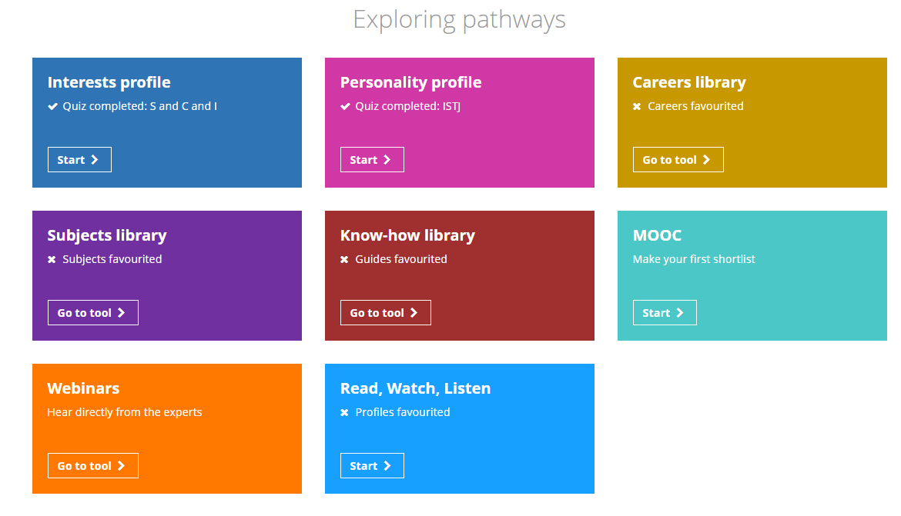

Slide 23
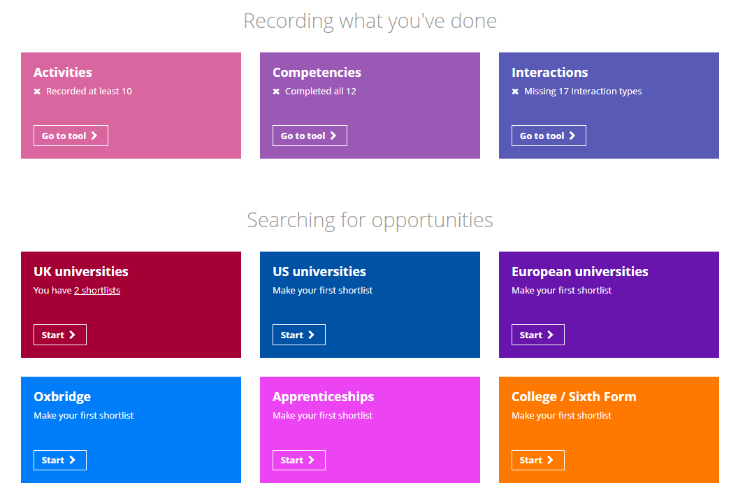

Slide 24
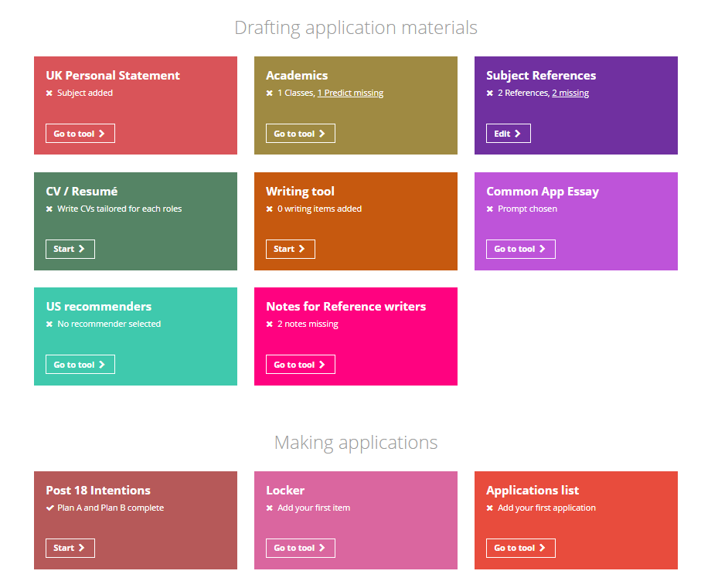

Slide 25
Post-18 Planning
During Year 12, all students are expected to:
Explore potential post-18 routes (university, apprenticeships, degree-level apprenticeships, employment, gap years, studying abroad)
Start their UCAS application (May/June)
Write a personal statement (first draft completed by start of Year 13)
Be curious – ask questions, research opportunities
Request a Form Tutor reference (July to November)
Participate in all morning registration activities and attend all Core sessions.
Predicted grades will be based on performance in Year 12 and the October tracking grades in Year 13.
Course choices will be dependent upon performance (predicted grades).

Slide 26
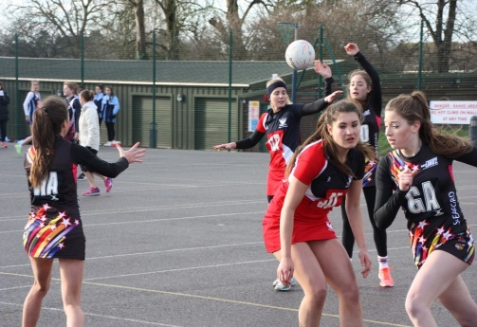
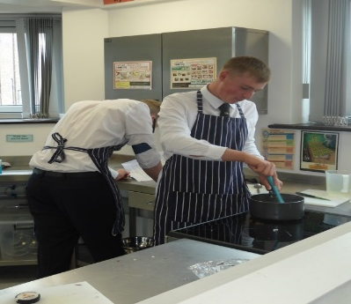
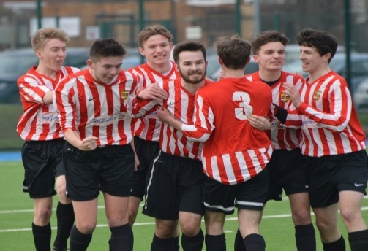
Enrichment
Opportunities for students to broaden their Sixth Form experience beyond their subjects.
Helps with personal development (transferrable skills) and impresses universities and employers – makes students stand out!
Extended Project Qualification
MOOC and Lectures
STEP Maths
Critical Thinking/Debating current affairs
Work Experience/Volunteering
Cooking & Living on a Budget
Book Club
Sewing Bee
Sport – football, rugby, netball, indoor sport, fitness suite, HIIT, volleyball
Arts Award
Music Appreciation
Duke of Edinburgh Award
Roles of Responsibility e.g. Prefect, House Captain, Form Prefect, School Council, Wellbeing Ambassadors, Senior Team.

Slide 27
Extended Project
Students can choose to take Extended Project/EPQ.
Lessons: 1-hour per week of formal lessons.
Out of lessons: expectation of an additional 2-hours of private study.
Past questions:
Dissertations:
  What is the Inverse Care Law and how is it influenced?
  To what extent does the football industry operate as a business?
  The impact of Post-Polio Syndrome: is a generation being failed by a lack of research?
  Were serial killers from the 1950s onwards predisposed to kill?
  Is the NHS nursing shortage in England due to inadequate pay?
  What are the causes, effects and current solutions to plastic pollution in the North Pacific ocean?
  Does China need feminism?
Artefacts: A play; a graphic design poster; novel; work of art; robot.

Slide 28
Work Experience
18-22 July 2022
At the end of the Summer Term, all Year 12 students in the
SJSF are expected to complete a week of work experience.
Students should start planning this as early as possible.
What should students be doing:
Write to employers of interest to request a placement
(following up with a call if necessary).
Once confirmed, complete the ‘Work Experience Placement Form’ and return this, along with the employer confirmation, to
Mrs Hunter to process the placement.
Mrs Hunter will email the form to students.

Slide 29
16-19 Bursary
A discretionary fund to support eligible young people with the costs of transport, books, educational visits or other course materials or equipment essential to successfully completing their programme of study; maximum £900 year
Specific financial criteria apply in order to receive a bursary: evidence required to support their application e.g. family tax credits, income support, means tested benefits.
Payments depend on a student meeting the Sixth Form expectations regarding academic work, behaviour and also maintaining a minimum of 90% attendance at morning registration and lessons.
Information and application form – on sixth form area of KSHS website or students can collect from the Sixth Form Office.

Slide 30

Thank you for listening.

